Slide 1
To Automate the Web page using Selenium Script
M. POOJHA
KPRIET
Final Year ECE

Slide 2
INTRODUCTION
Selenium is a portable framework for testing web applications.
Programming languages C, python, Java.
It has four different tools namely Selenium RC, Selenium IDE, Selenium Grid, Selenium WebDriver.
This is an open source tool so it can be accessible easily.
It allows for recording, editing and debugging of functional tests.

Slide 3
OBJECTIVE
To automate the flow of web page by using Selenium Script.
To fill the contact us form by using selenium script.

Slide 4
APPROACH
Download Selenium-3.141.0-py2.py3
Install the chrome driver
Install PyCharm software for execution
Loading the home page
Navigate to other pages
Contact Us form is filled by using Selenium Script
Submit the form by using selenium script

Slide 5
USE CASE
It is used for UI Automation.
Testers can test how the website or software reacts after repeated execution of the same operation.
Tests can be re-used on different versions of the software.
Tests perform precisely the same operation each time they are run thereby eliminating human error.

Slide 6
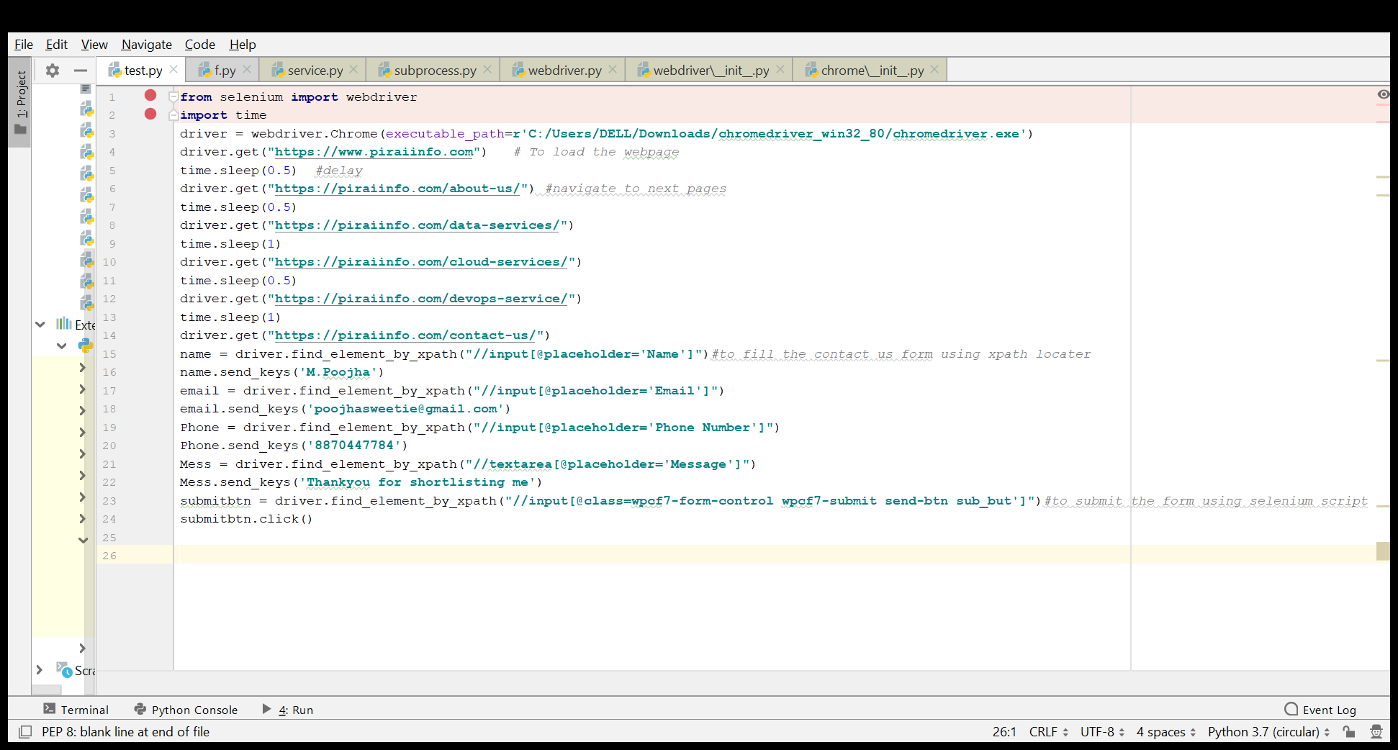

Slide 7
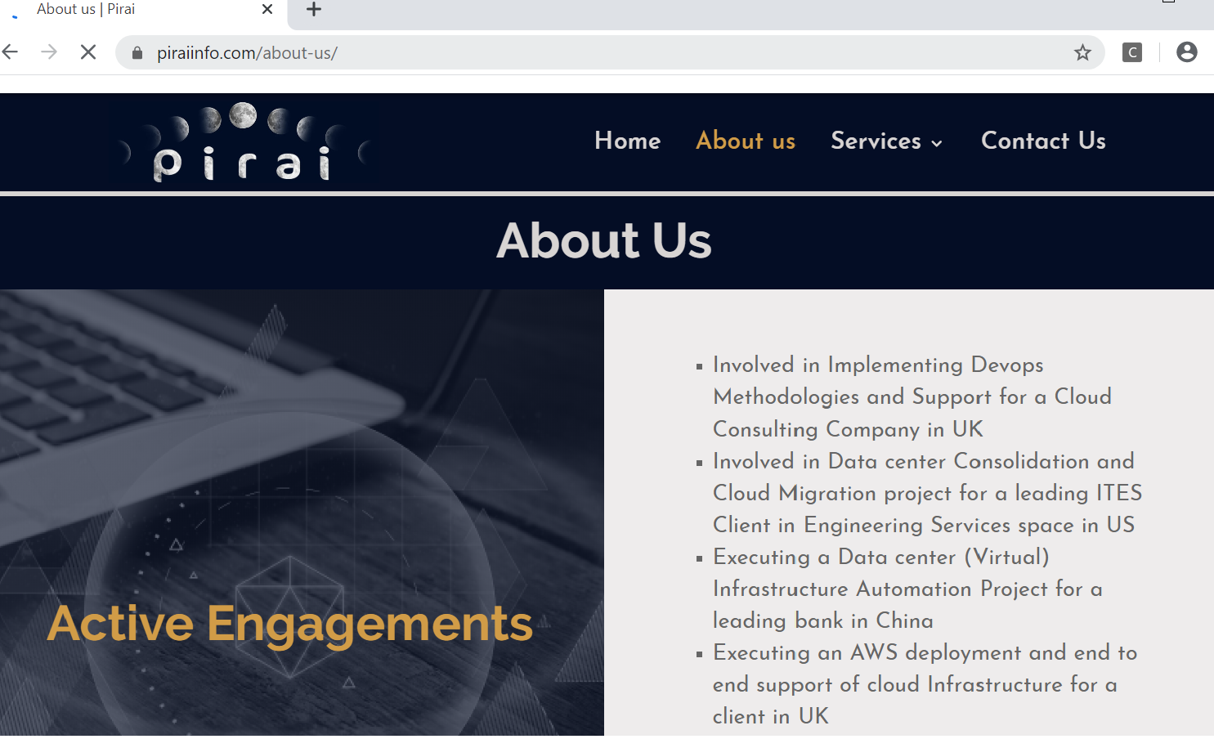

Slide 8
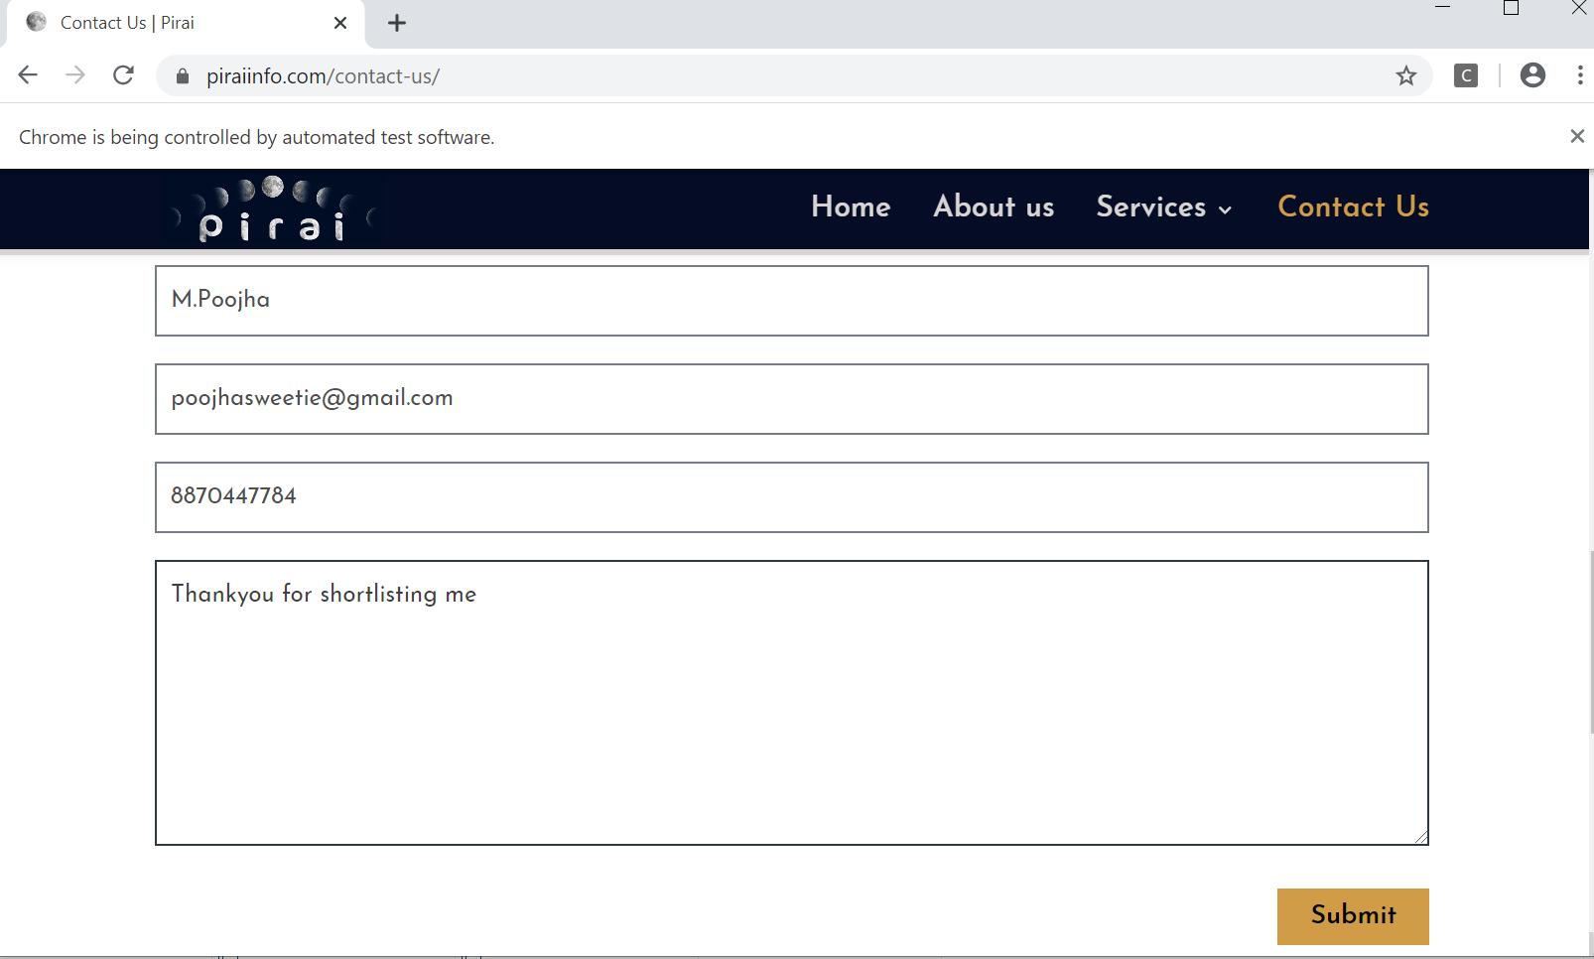

Slide 9
Thank You

